Slide 1
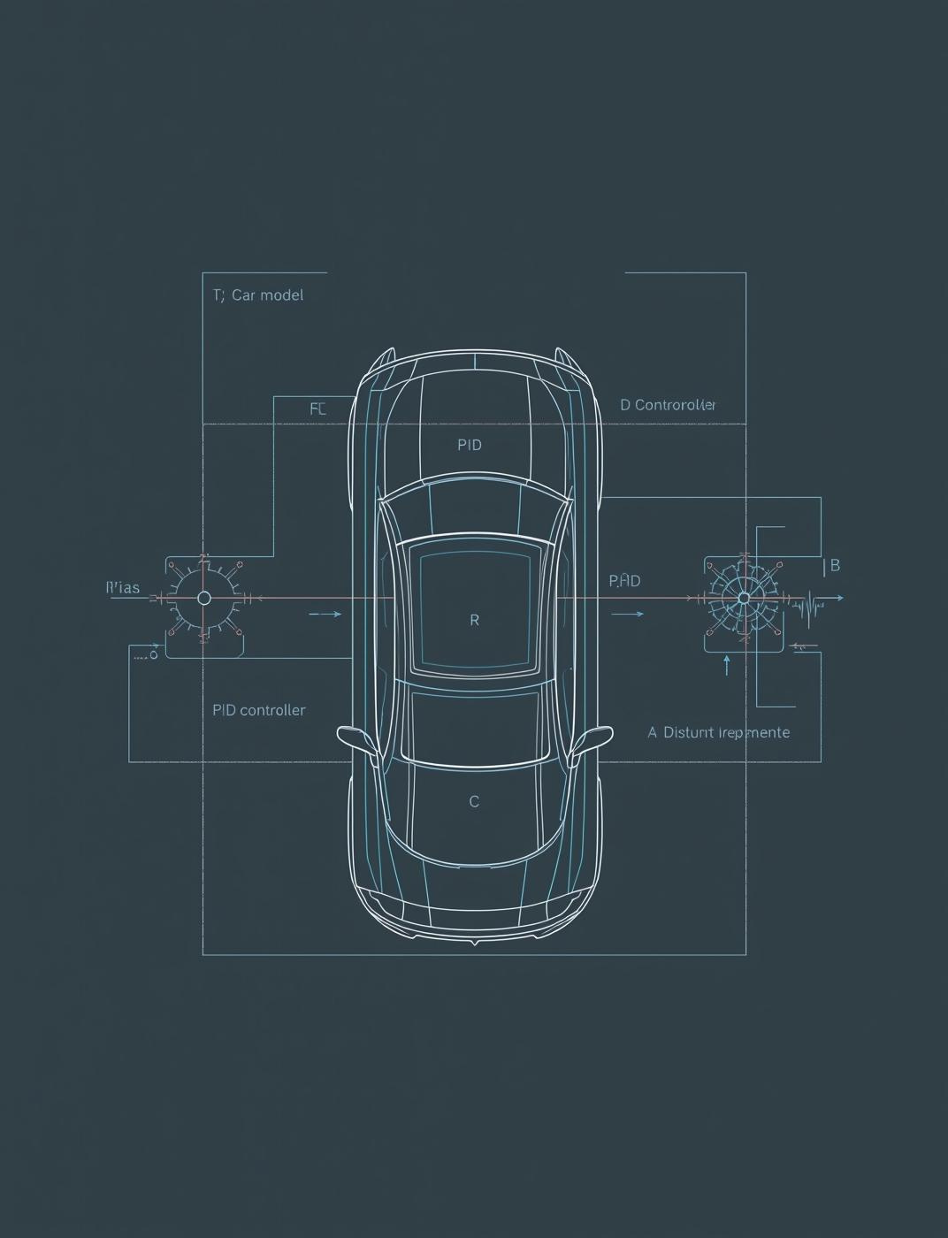
Application of Control Systems
Demonstrating Disturbance Rejection with a PI Controller
Rudra Pratap Singh
Control Systems Student

Slide 2

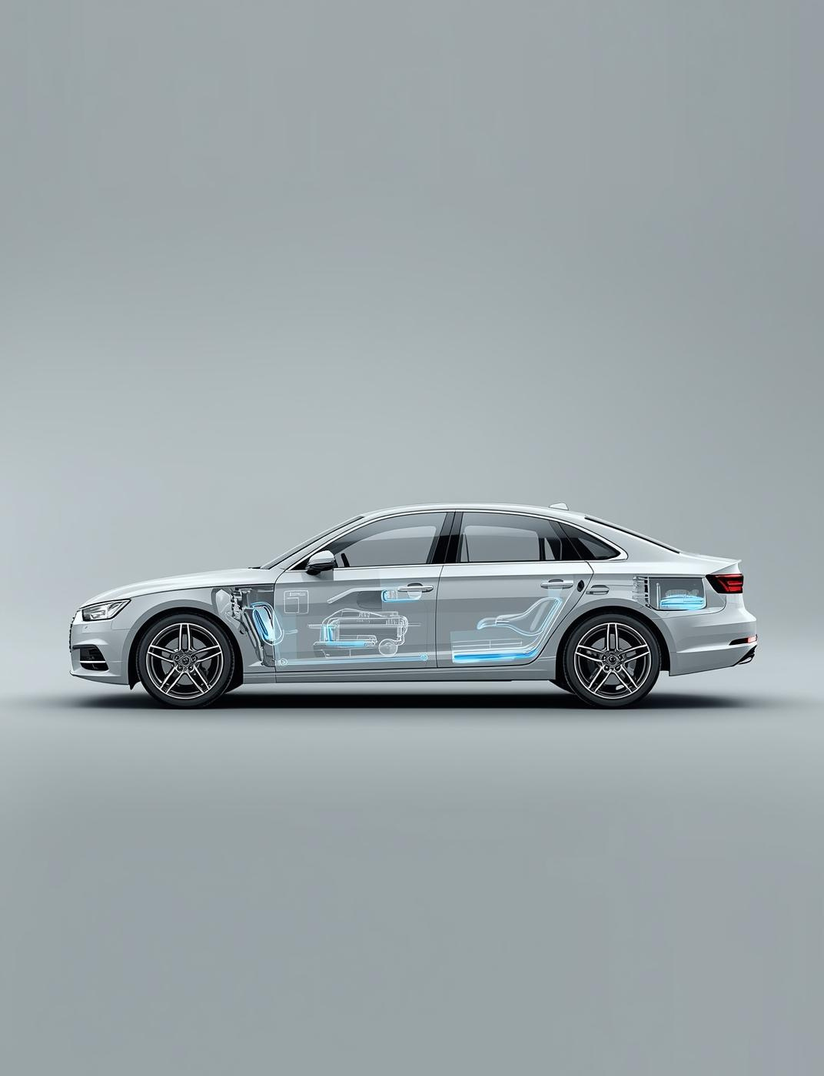
Cruise Control Overview
Understanding Automatic Speed Control Systems
Cruise control automates the vehicle's speed, allowing drivers to set a desired pace. It adjusts engine power to maintain speed despite changes in road conditions or external forces.

Slide 3
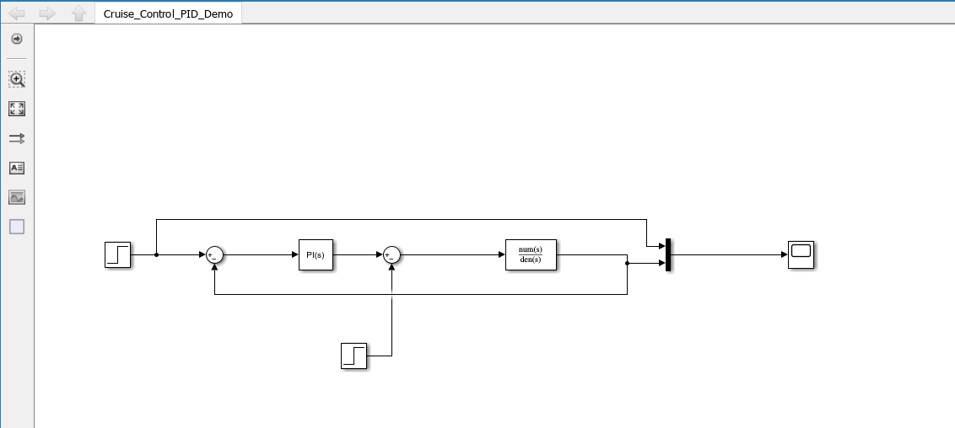

System Model
This Simulink model illustrates the cruise control system architecture, including key components that simulate the car's response to various driving conditions and disturbances effectively.

Slide 4
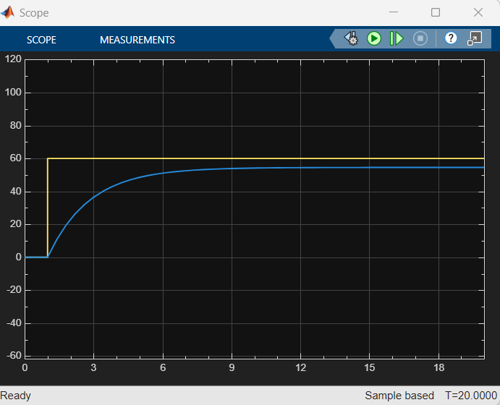
P-Controller Results
The P-controller simulation demonstrates a significant speed drop when faced with a disturbance, resulting in a steady-state error that persists throughout the test.

Slide 5

Analysis of P-Controller
Speed Limitation
Speed never reaches target of 60 km/h.
Understanding Steady-State Error in Performance
Disturbance Impact
Speed drops significantly when the hill occurs.
Steady-State Error
Persistent error leads to inadequate speed control.
Control System Failure
Proportional control alone cannot adjust appropriately.

Slide 6
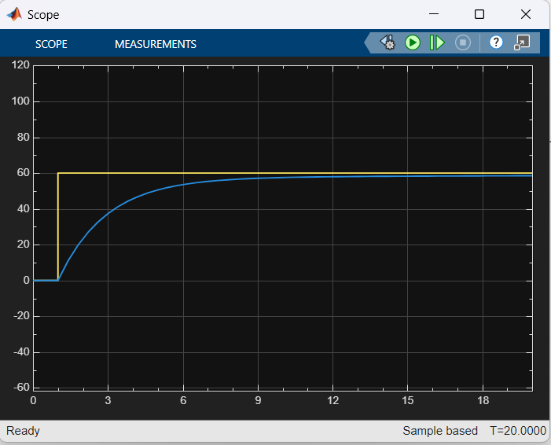
PI-Controller Performance
The PI-controller effectively manages disturbances, achieving the target speed of 60 km/h with no steady-state error, demonstrating its superiority in maintaining performance under varying conditions.

Slide 7
Analysis of PI-Controller
Steady-State Achievement
Speed maintains target at 60 km/h effectively.
Understanding Zero Steady-State Error
Disturbance Response
Controller quickly recovers from disturbances like hills.
Integral Action
Integral term counters persistent errors over time.
Real-World Application
PI controllers are crucial for practical control systems.

Slide 8
Comparison of P-Controller and PI-Controller
P-Controller
PI-Controller
Cannot handle disturbances, resulting in steady-state error.
Effectively eliminates steady-state error and counters disturbances.

Slide 9
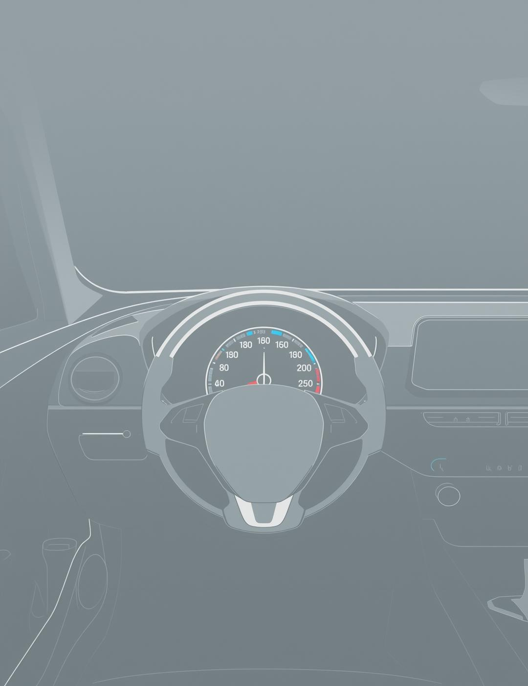
Thank You

